Slide 1


Social Buzz

Slide 2


Today's agenda
Project recap
Problem
The Analytics team
Process
Insights
Summary

Slide 3

Social Buzz is a fast growing technology unicorn that need to adapt quickly to it's global scale. Accenture has begun a 3 month POC focusing on these tasks:
An audit of Social Buzz's big data practice
Recommendations for a successful IPO
Analysis to find Social Buzz's top 5 most popular categories of content
Project Recap

Slide 4

There is an opportunity to leverage this vast user base.
There is an opportunity to leverage this vast user base.
Problem
Over 500 Million active monthly users who post over 100,000 pieces of content daily
There is an opportunity to leverage this large user base.
Analysis to find Social Buzz's top 5 most popular categories of content

Slide 5



Elton S
Data Analyst
The Analytics team
Emily Davis
Senior Principal
Michael Castillo
Chief Technology Architect

Slide 6
Process
1
Data Understanding
2
Data Cleaning
3
Data Modelling
4
Data Analysis
5
Unrcover Insights

Slide 7

Insights
Most Popular Category: Animals
74965 Reactions
Least Popular Category: Public Speaking
49264 Reactions
Positive Reactions: 56.2%

Slide 9
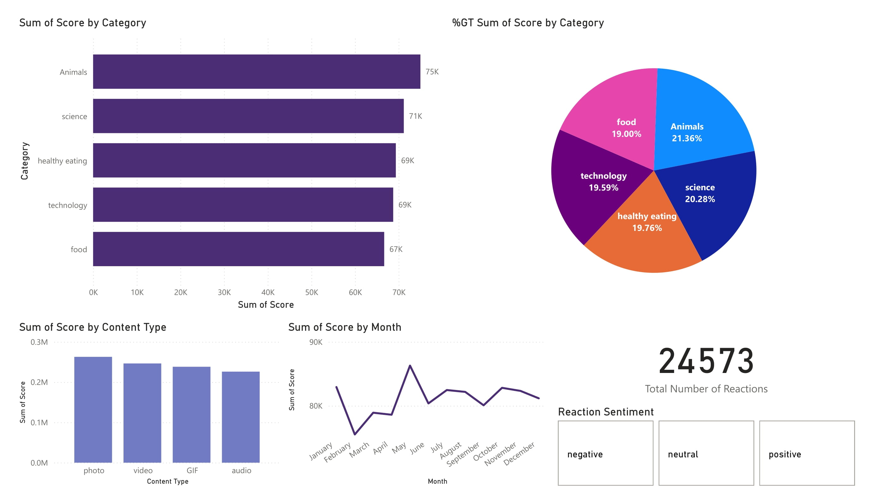

Slide 10

The inclusion of Healthy Eating and Food in the top five categories highlights Social Buzz users' strong interest in culinary content, reflecting their enthusiasm for nutrition and recipes.
ANALYSIS
The presence of Animals, Science and Technology in the top 5 most popular categories of content suggests that Social Buzz users enjoy informative content the most.
The inclusion of Healthy Eating and Food in the top five categories highlights Social Buzz users' strong interest in culinary content, reflecting their enthusiasm for nutrition and recipes.
NEXT STEPS
To capitalize on user engagement in the top content categories Social Buzz should enhance its content strategy by setting clear goals, embracing current trends, and fostering community interaction through polls and quizzes. Collaborations with influencers in the fields of health, nutrition, and science will help in reaching a broader audience.
Summary

Slide 11
Thank you!
ANY QUESTIONS?

